Slide 1
Welcome to our presentation on Female Freelancing

Slide 2
Group Members
Md. Masud(141-35-587)
Syeda Shaila(141-35-617)

Slide 3
Topic
What is Freelancing?
What does mean Female Freelancing?
Objectives of Female Freelancing.
Expectation of Freelancing for female.
Female Freelancing Activities.
Project Duration.
Project Budget.
Used Technologies.

Slide 4
What is Freelancing?
Freelancing means to do work free from other persons dominating.
Freelance work presents a better range of different jobs as compared to a normal employment.

Slide 5
What does mean Female Freelancing?
Women are more likely to be independent worker. Freelancing is a great way of earning a living for female who work at home.
Female person are more prefer to freelancing job cause they maintain their family at a same time.

Slide 6
Expectation of Freelancing for female.
To encourages the women power.
Providing online marketing knowledge.
Making higher financial support for a country.

Slide 7
Objectives of Female Freelancing.
The objective of this project is to develop an online marketplace for the female.
The marketplace will mainly focus on the women throughout the world.
The freelancing woman is open to decide his working hours & working method.

Slide 8
Female Freelancing Site Activities.
Anyone can visit the site and post any kind of project as a hirer.
Freelancer can communicate through the application, even they can chat with their client.
They can participate in online exam to prove themselves.
Client or hirer can review and comment on freelancer profile.

Slide 9
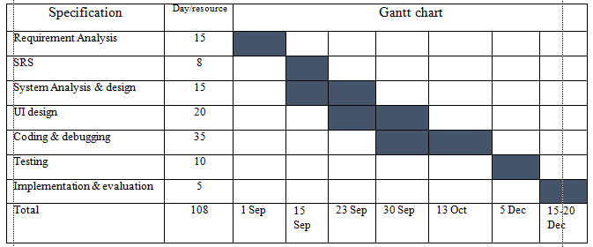
Project Duration.

Slide 10
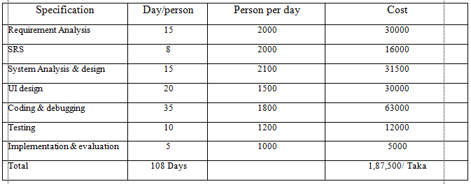
Project Budget.

Slide 11
Used Technologies.
Asp.Net MVC5
Microsoft SQL Server 2014
JavaScript (JQuery, Pure JavaScript)
CSS
SignalR
IIS (Internet Information Service) Hosting

Slide 12
THANK YOU

